Slide 1

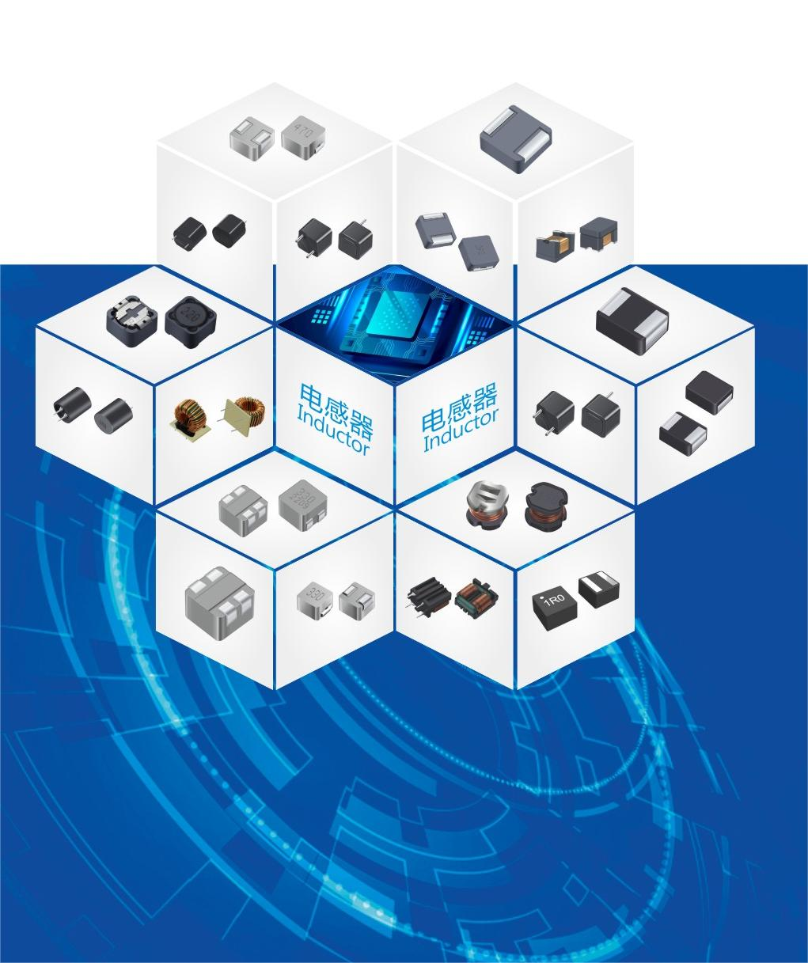

since 1991
Shenzhen Gantong Technology Co.,Ltd
Provide electromagnetic compatibility solutions for global customers

Slide 2
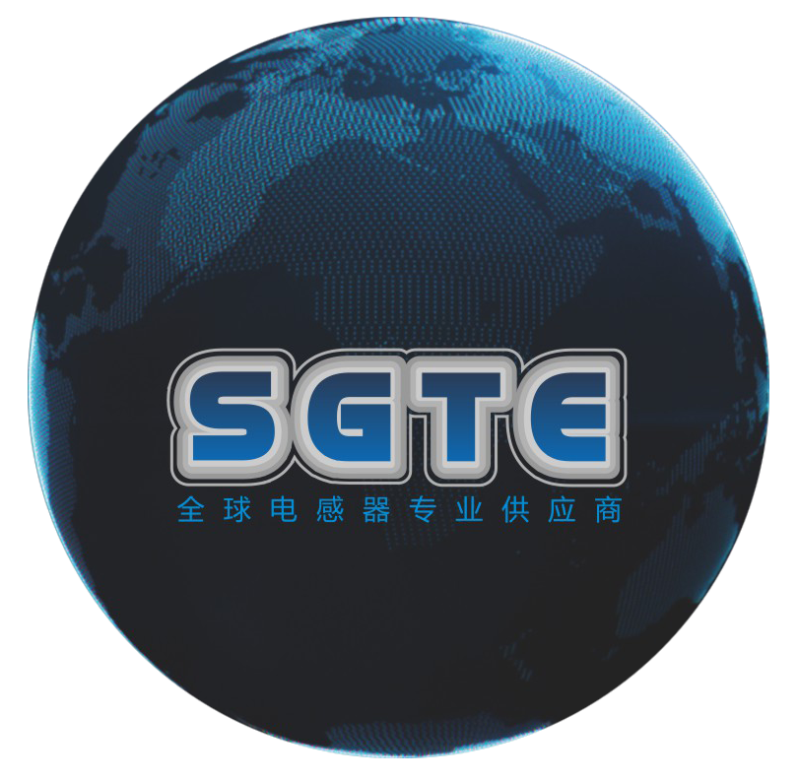
Catalogue
CONTENTS
01
Company Profile
02
Product Introduction
03
Service Show
04
Market Distribution
05
Contact Us

Slide 3
1
  Enterprise Profile
※ Company Profile
※Development History
※ Corporate Culture
PART
※ Company Honors
※ Operating system

Slide 4
Company Profile
Shenzhen Gantong Technology Co.,Ltd
SGTE Inductor was founded in 1991,one of the leading domestic manufacturers for inductor research and development.Adhering to the development philosophy of "To become a qualified product, become a qualified person first, we are always committed to the research and development, production and manufacturing of inductors; Our products cover various types of inductors, including Molded inductors, Common mode inductors, RF inductors, Toroidal inductors, Digital power amplifier inductors, etc. We are dedicated to solving electromagnetic compatibility problems for our customers. The products are widely used in fields such as new energy, automotive electronics, aerospace, artificial intelligence, healthcare, etc.

Slide 5
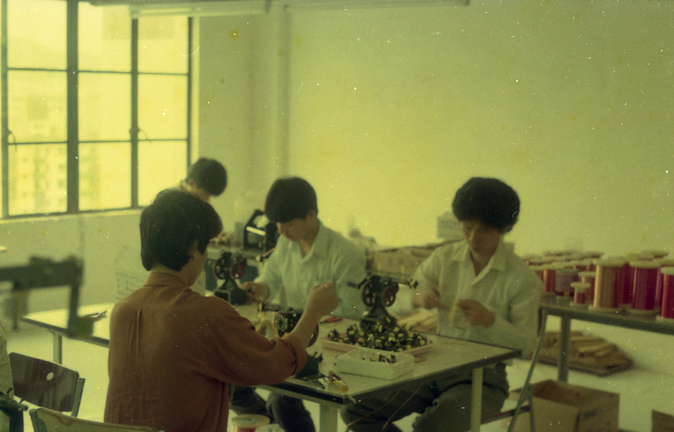

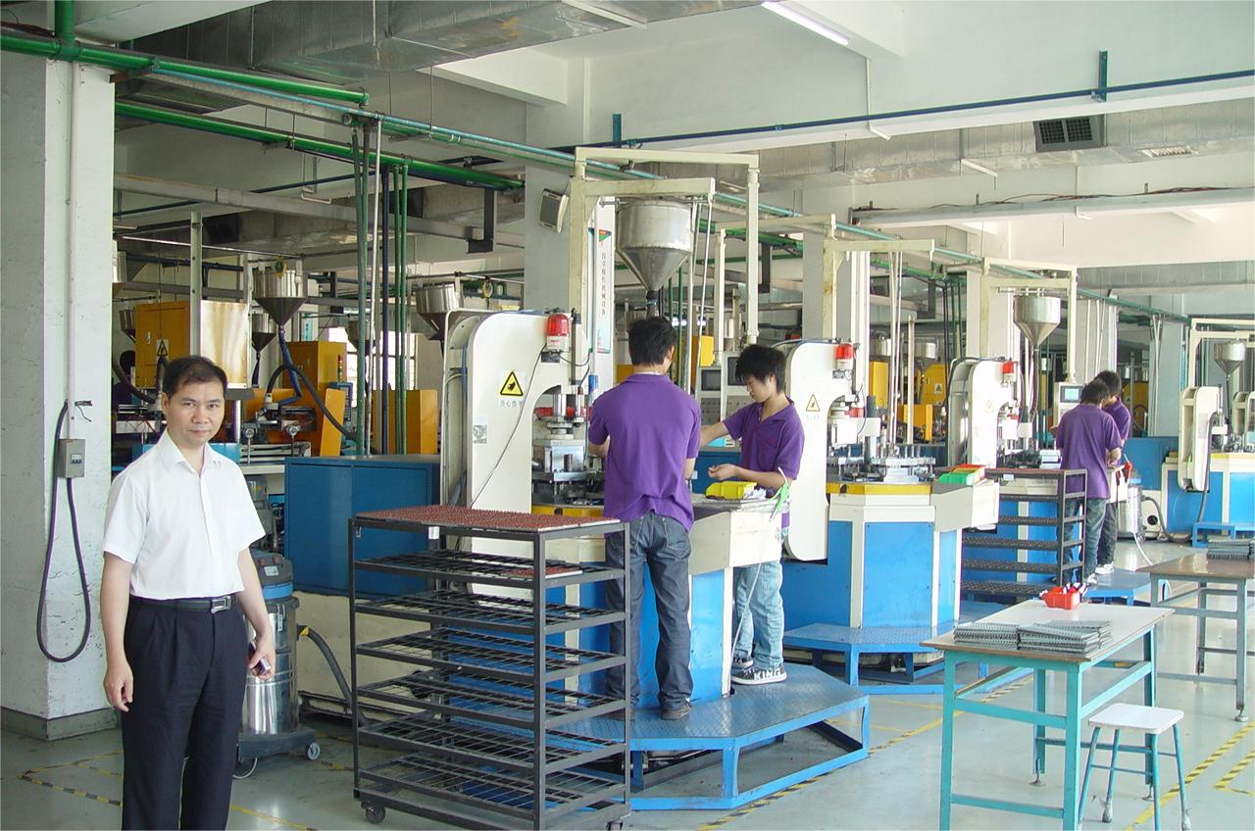
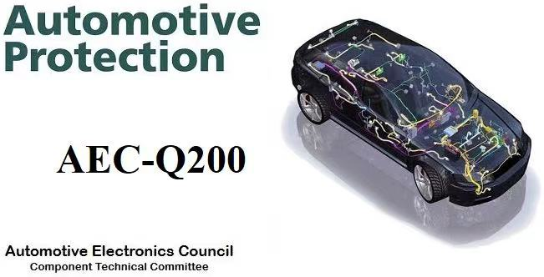
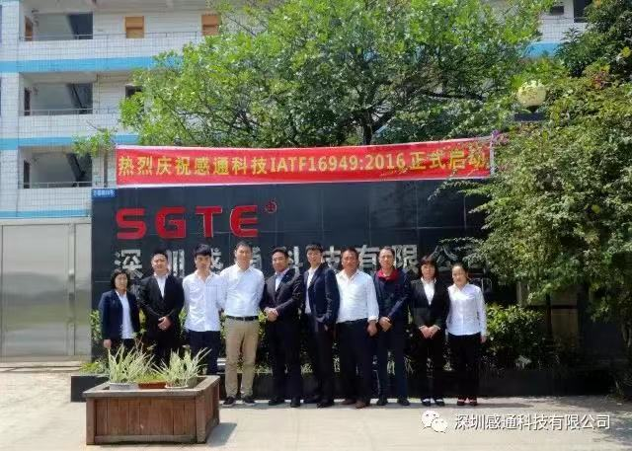
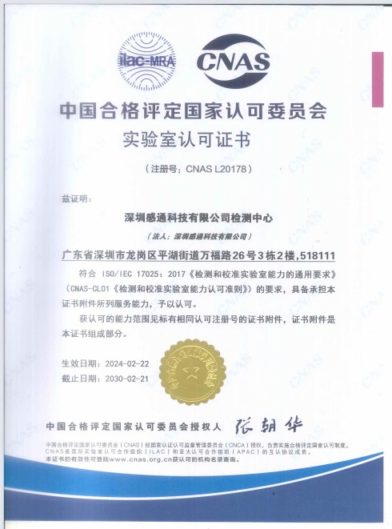
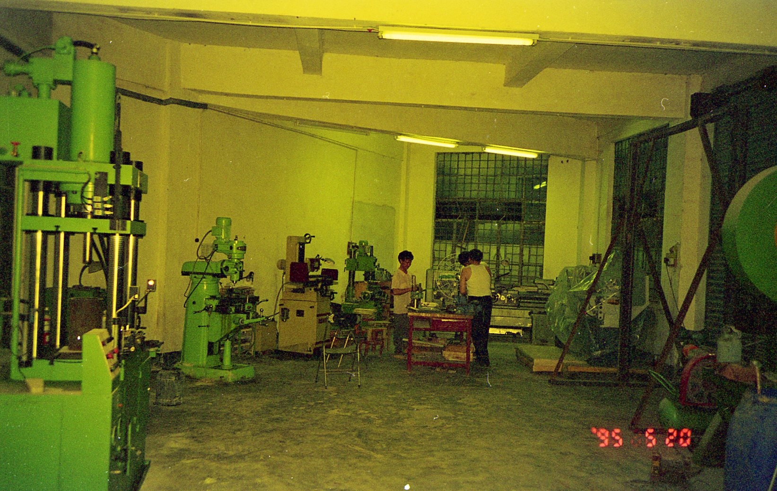
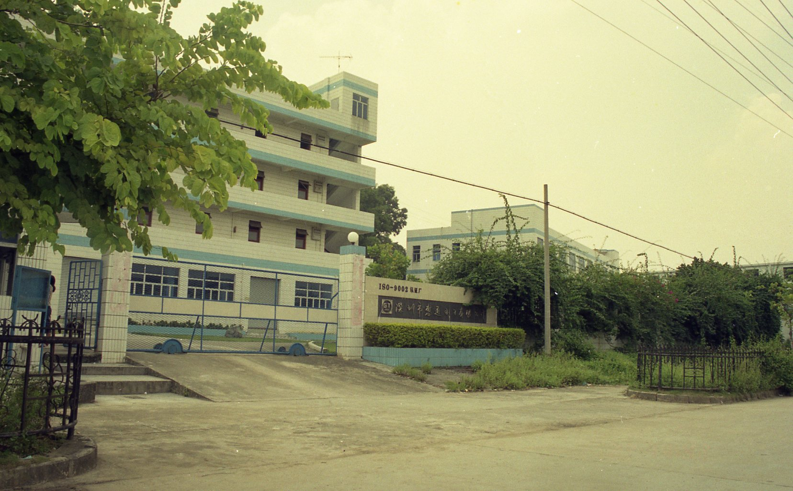
Development History
Hengtong Electronics,the predecessor of SGTE inductor was established in Zhuhai.
Purchase industrial land and build the Gantong Industrial Park
All series of products have passed the AEC-Q200 quality standard
Fully import molded inductor production line
1991
1995
1997
2004
2008
2017
2020
2024
Gantong Electronics Established in Pinghu, Shenzhen
Gantong Technology was established
The company's laboratory has been officially recognized by CNAS
Approved by IATF16949 Automotive Quality System Certification

Slide 6
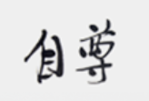
Corporate Culture
The Origin of the Name "Gantong"
Self-esteem
Principle
Low key
Low profit
The word "Gantong" comes from "Yi Zhuan · XiCi Zhuan". The original text is "Feeling and then connecting, the reason for the world". It was personally named by Mr. Wang Xiangqun, the chairman of the company, carries the belief of Gantong workers: Dare to be the first, forge ahead, feel sincerity, and connect with every touch
Careful
Method
Insist
Summary
The Origin of the Corporate Culture
Mr. Wang Xiangqun, the chairman of Gantong, has always regarded "people-oriented" as the creed and development way of the company since the beginning of entrepreneurship. Trustworthy corporate culture is: if you want to be a qualified product, be a qualified person first. He firmly believes that good products come from good character, and good quality comes from good diathesis.
Corporate Mission
Building a global brand and creating a century old enterprise

Slide 7
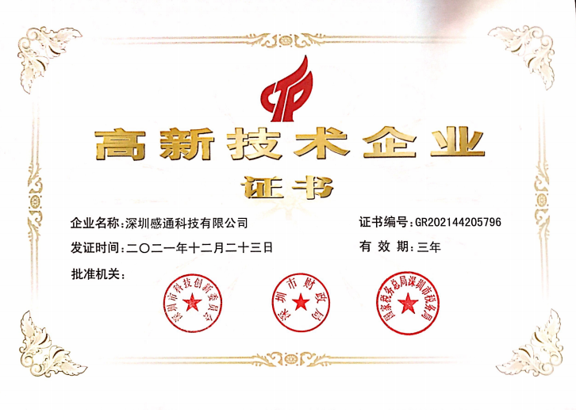
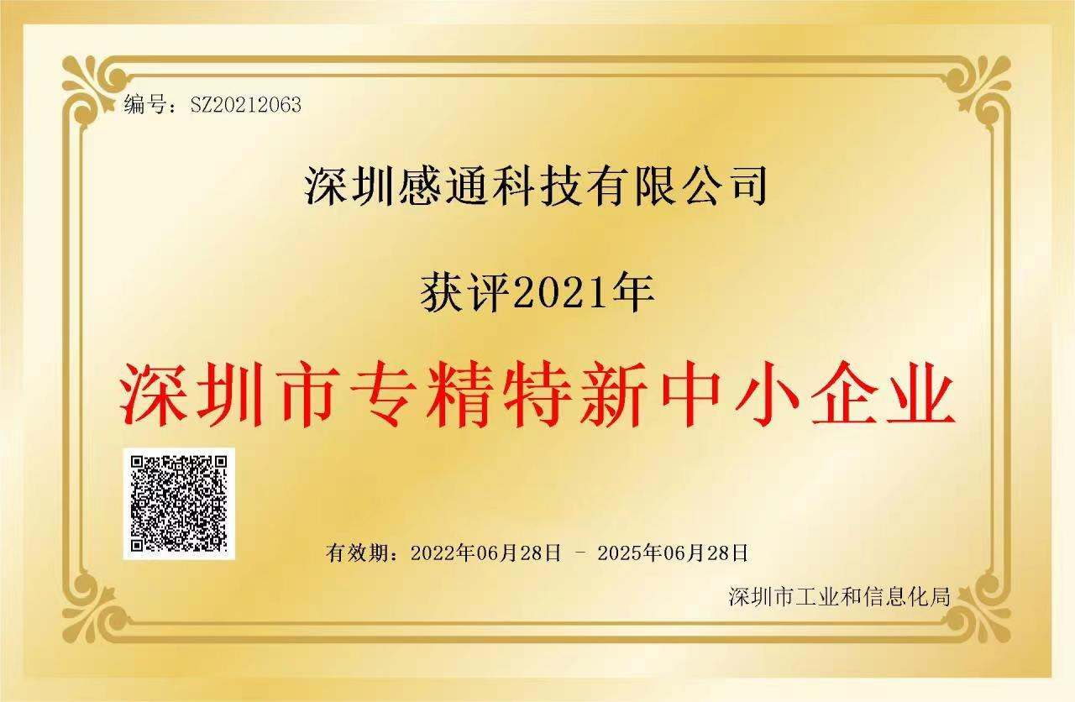
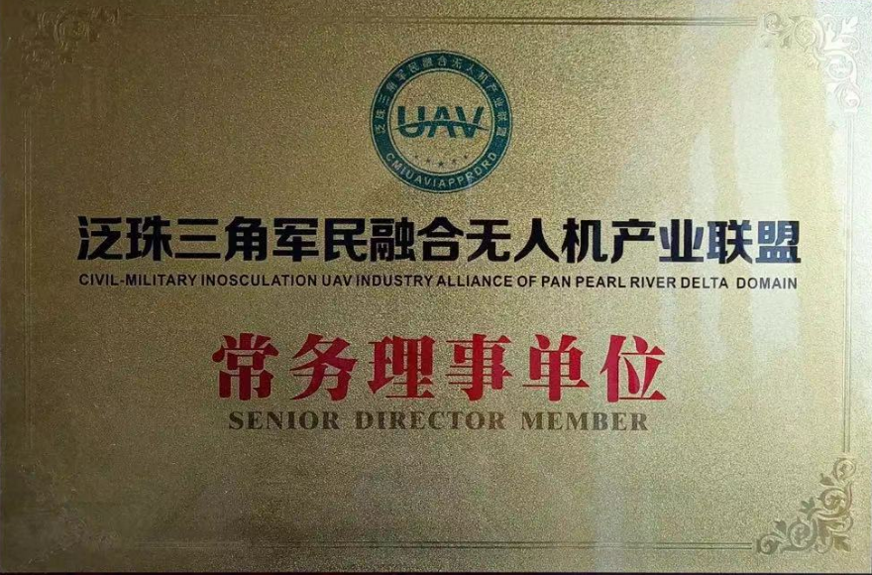
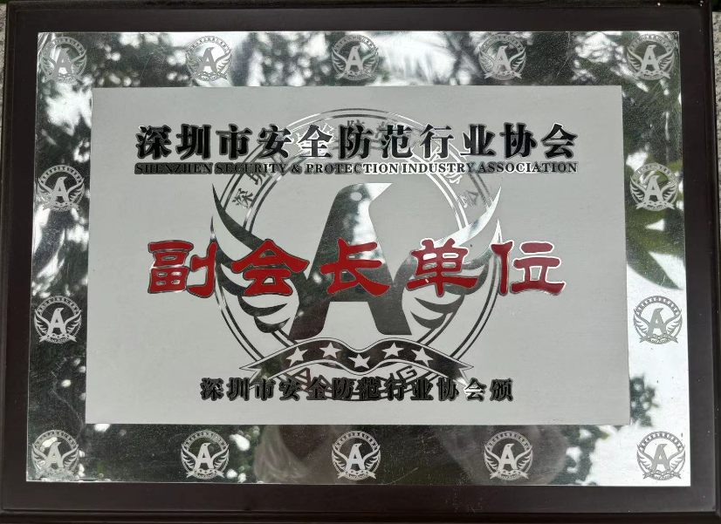
Company Honor
Since 2011, our company has been a national high-tech enterprise and has been awarded titles such as "Advanced Technology Enterprise" and "Excellent Enterprise in Transformation and Upgrading" by the street for many times

Slide 8
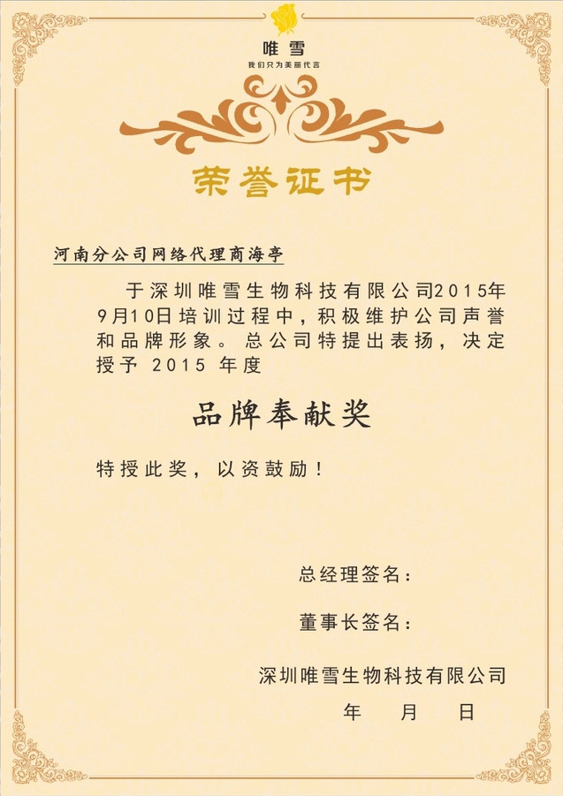
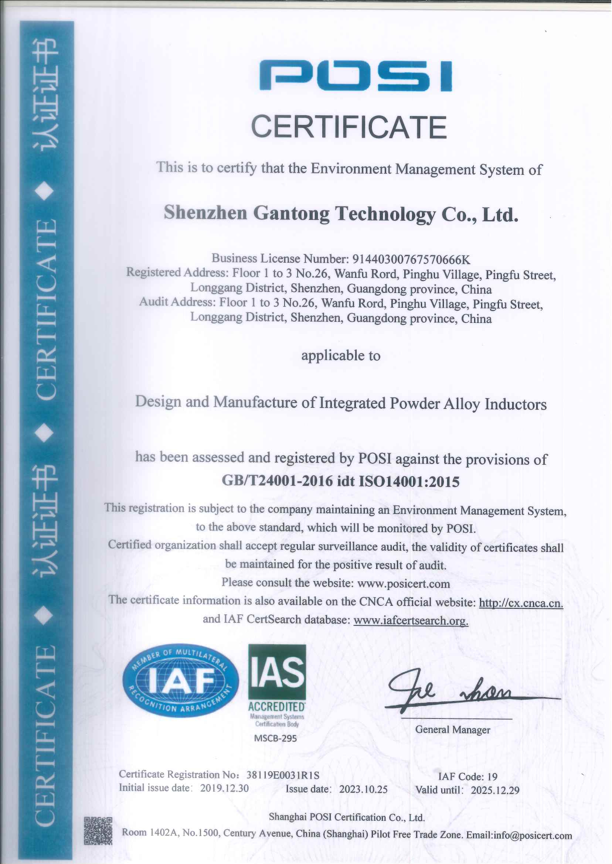
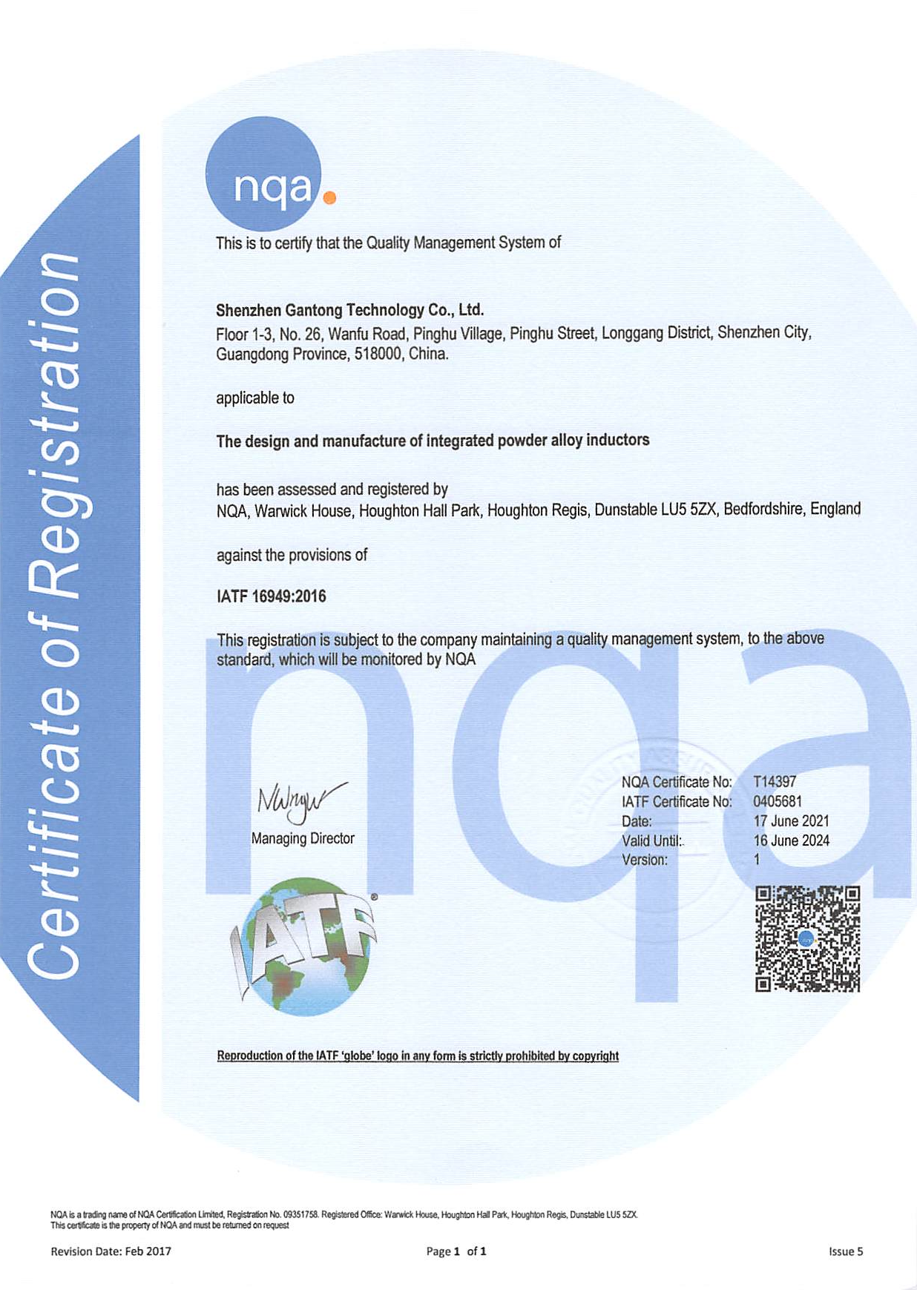
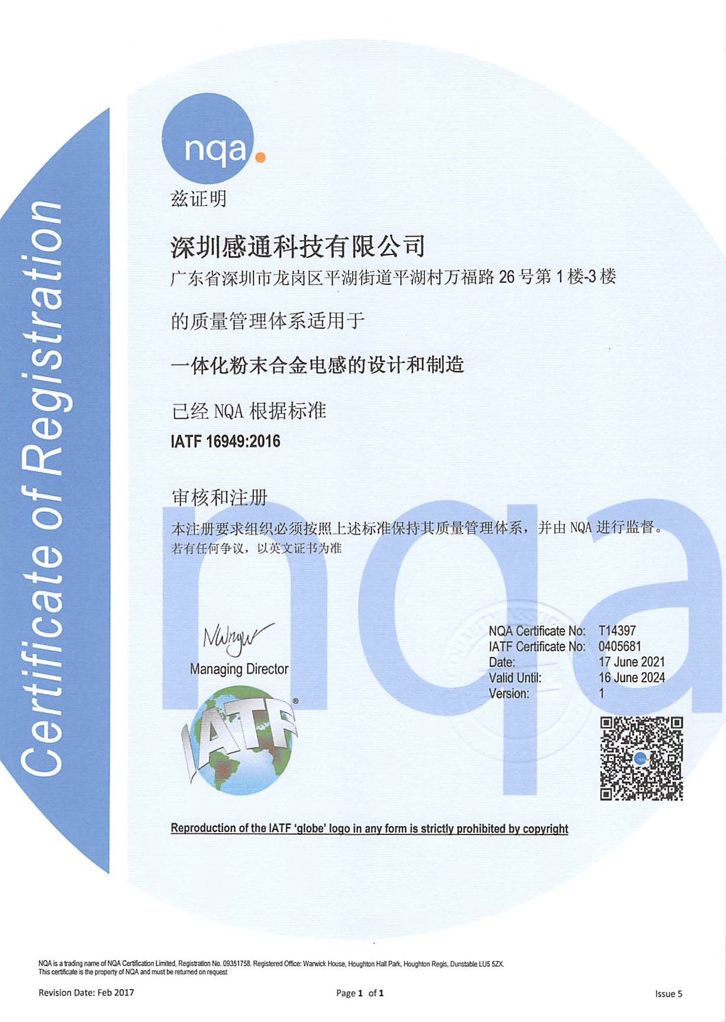
Operating system
Our company has passed the ISO9001 quality management system
ISO14001 Environmental Management System
IATF16949 Automotive Quality Management System

Slide 9
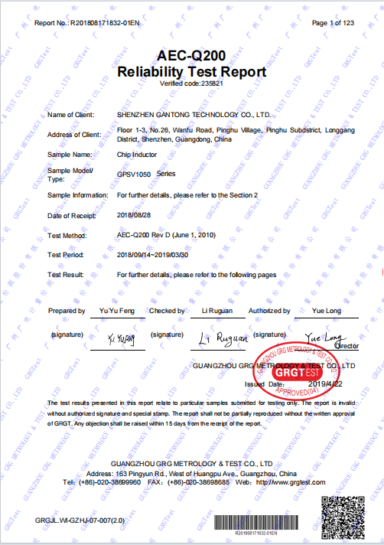
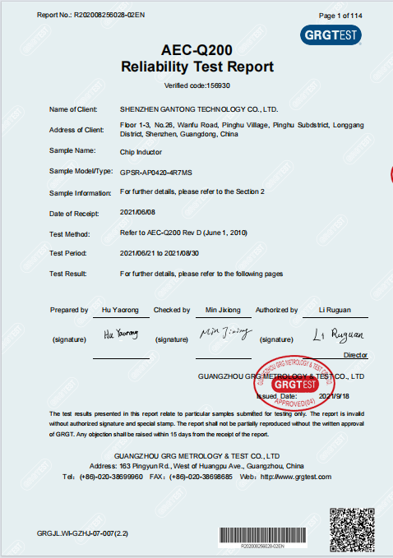

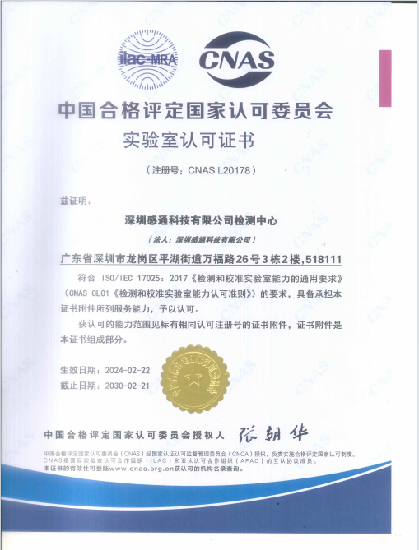
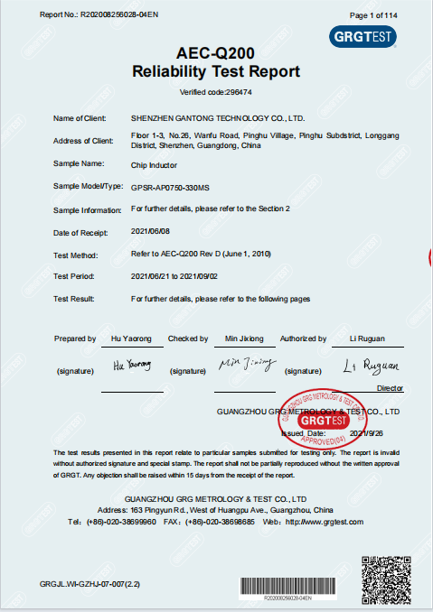
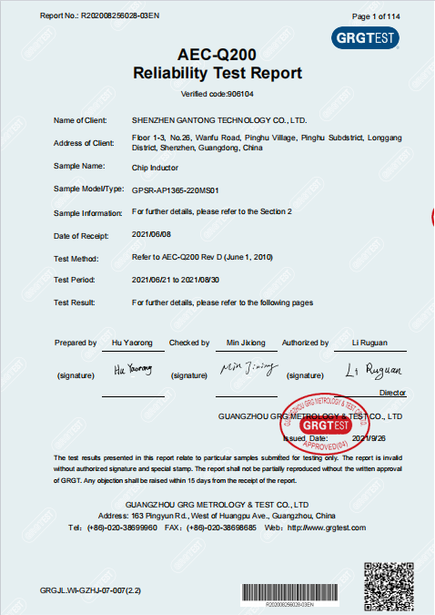
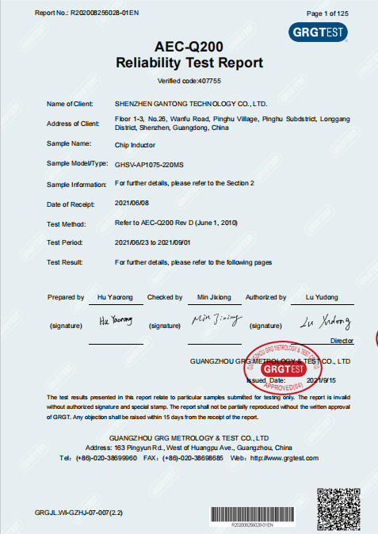
Quality Assurance
1. The company's products have passed third-party (radio and television metering) testing and meet the AEC-Q200 automotive quality standards
2. The laboratory established by the company according to the AEC-Q200 standard and recognized by CNAS

Slide 10
Quality and Environmental Policy
Quality objectives
Monthly defect rate of finished products ≤ 0.01%
No more than one customer complaint case per month
Customer return defect rate ≤ 0.01% per month
Quality policy
Step by step control, everyone's participation, providing customers with high-quality products and services at the most competitive cost, and continuously keep improving
Implement environmental protection and pollution prevention. Energy conservation and consumption reduction, striving to reduce waste.
Comply with regulations and communicate effectively. Continuous improvement and sustainable operation
Environmental policies
Harmful substance policy
Comply with regulations on environmental substance management and customer requirements
Necessary measures to promote the reduction of environmental pollution
Ensure reasonable control of harmful substances in the environment

Slide 11
2
  Product Introduction
※ Process flow
※ Main products
※ Technical indicators
PART
※ Production capacity
※ Related equipment
※ Application area

Slide 12
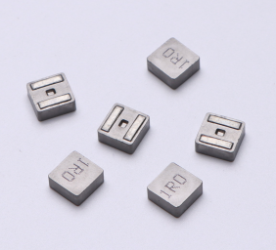
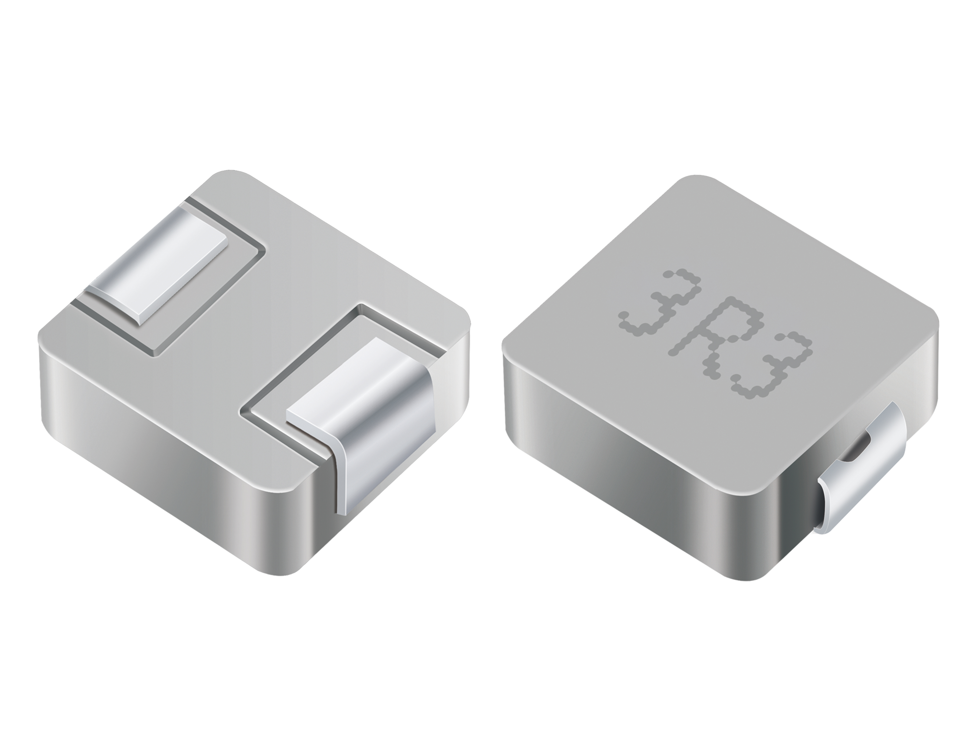
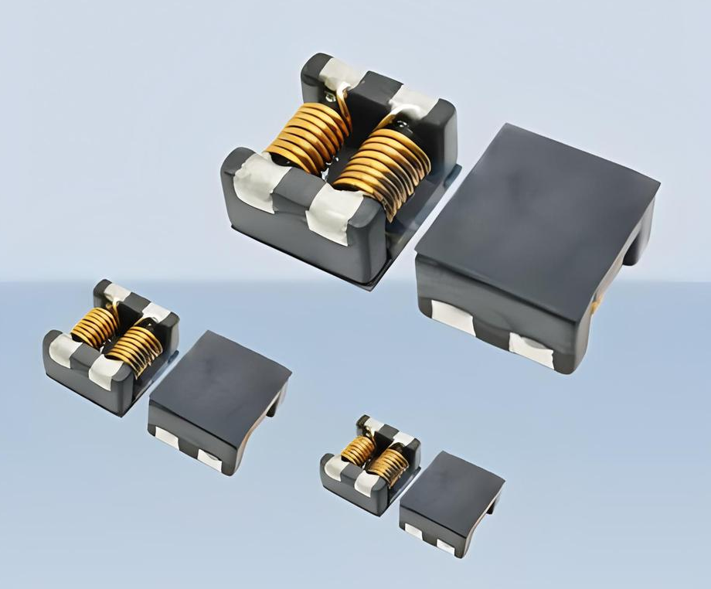
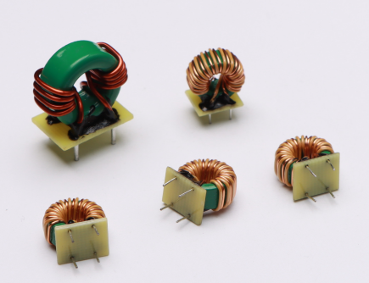
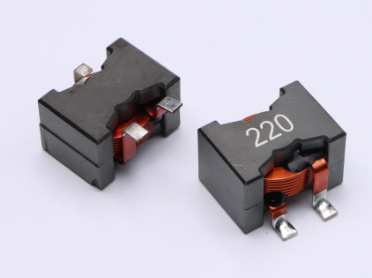
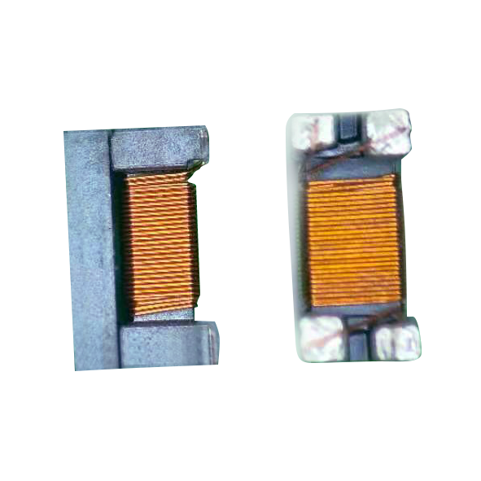
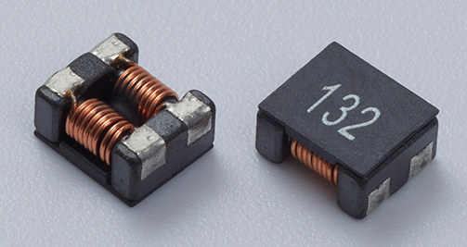
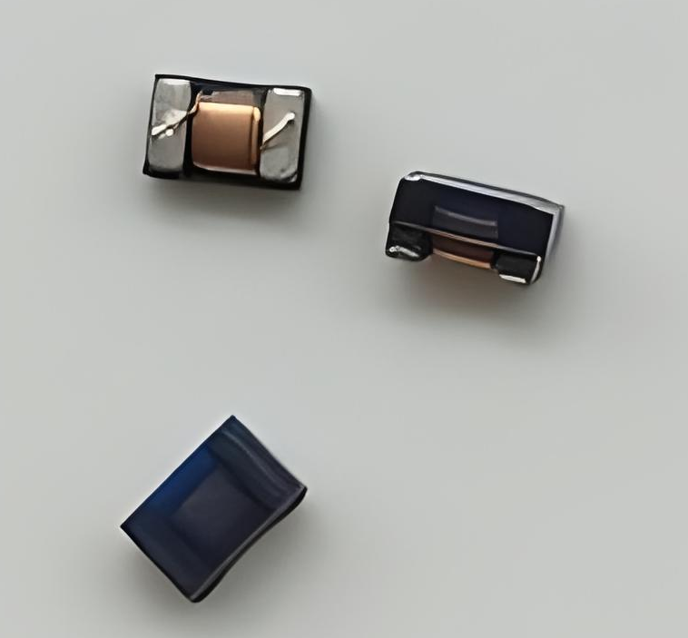
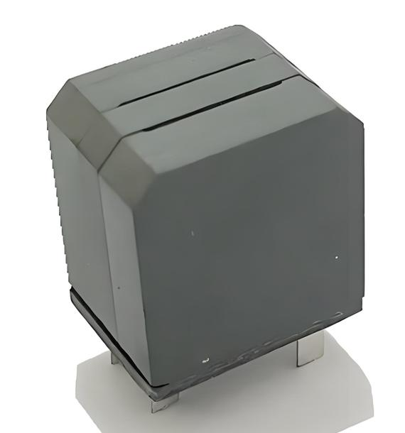
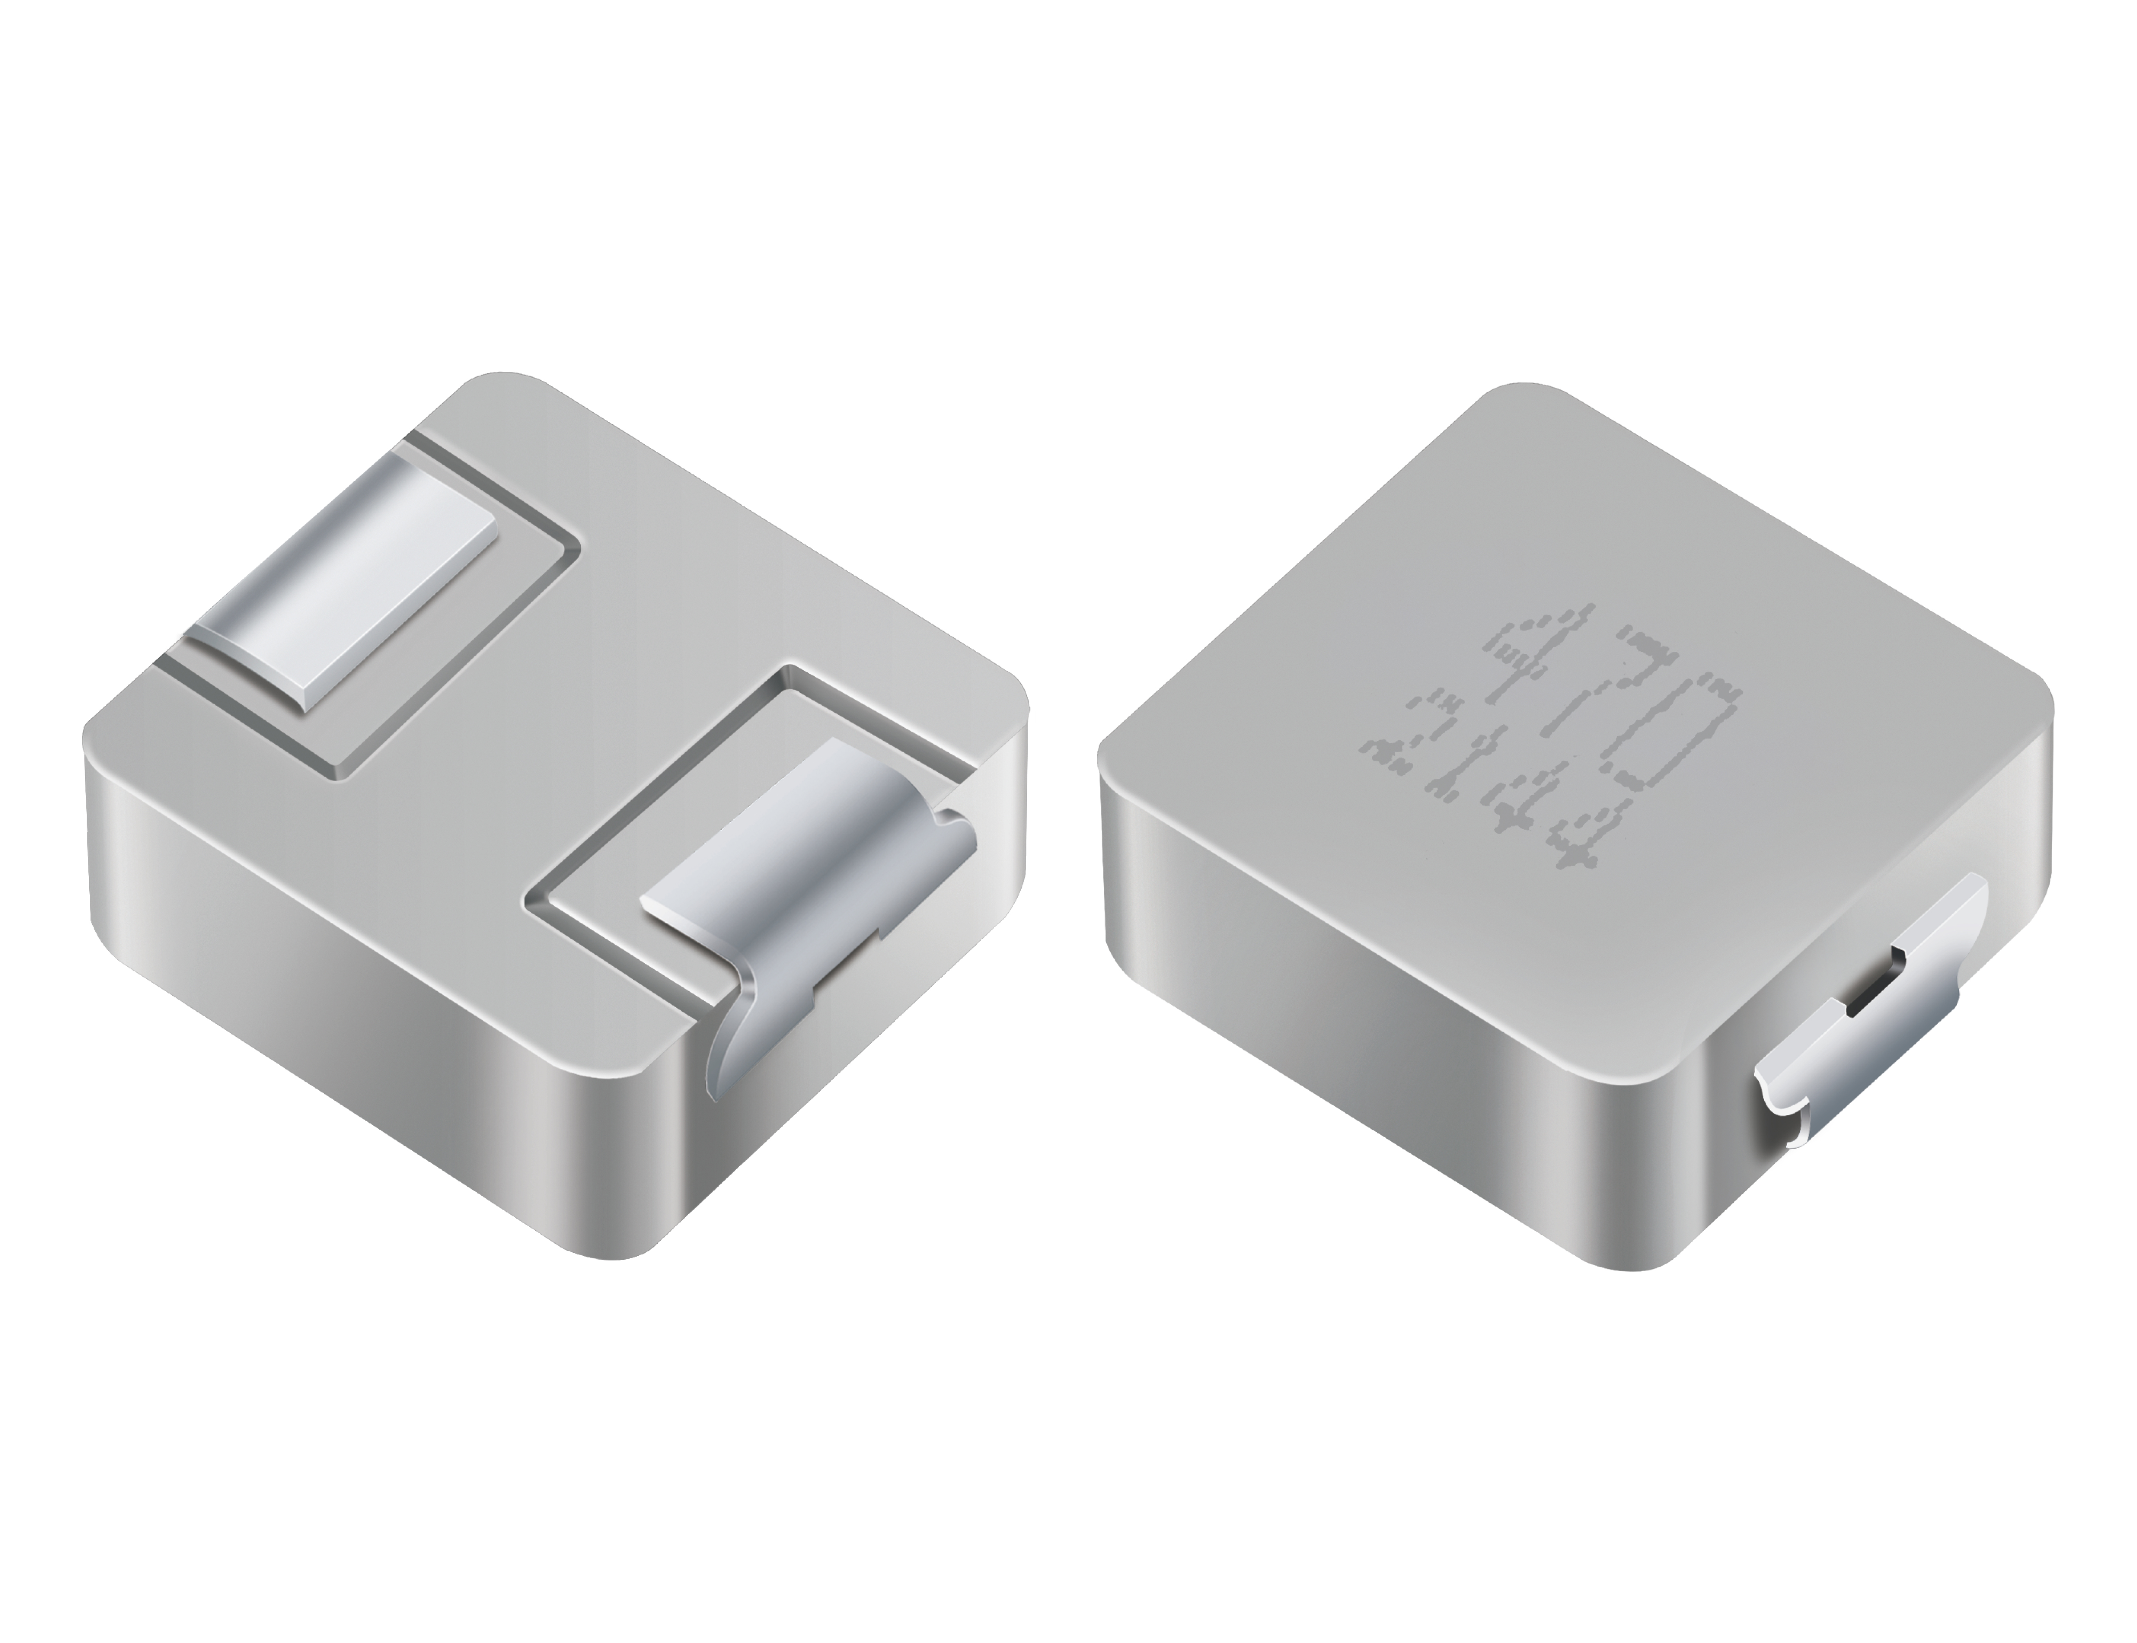
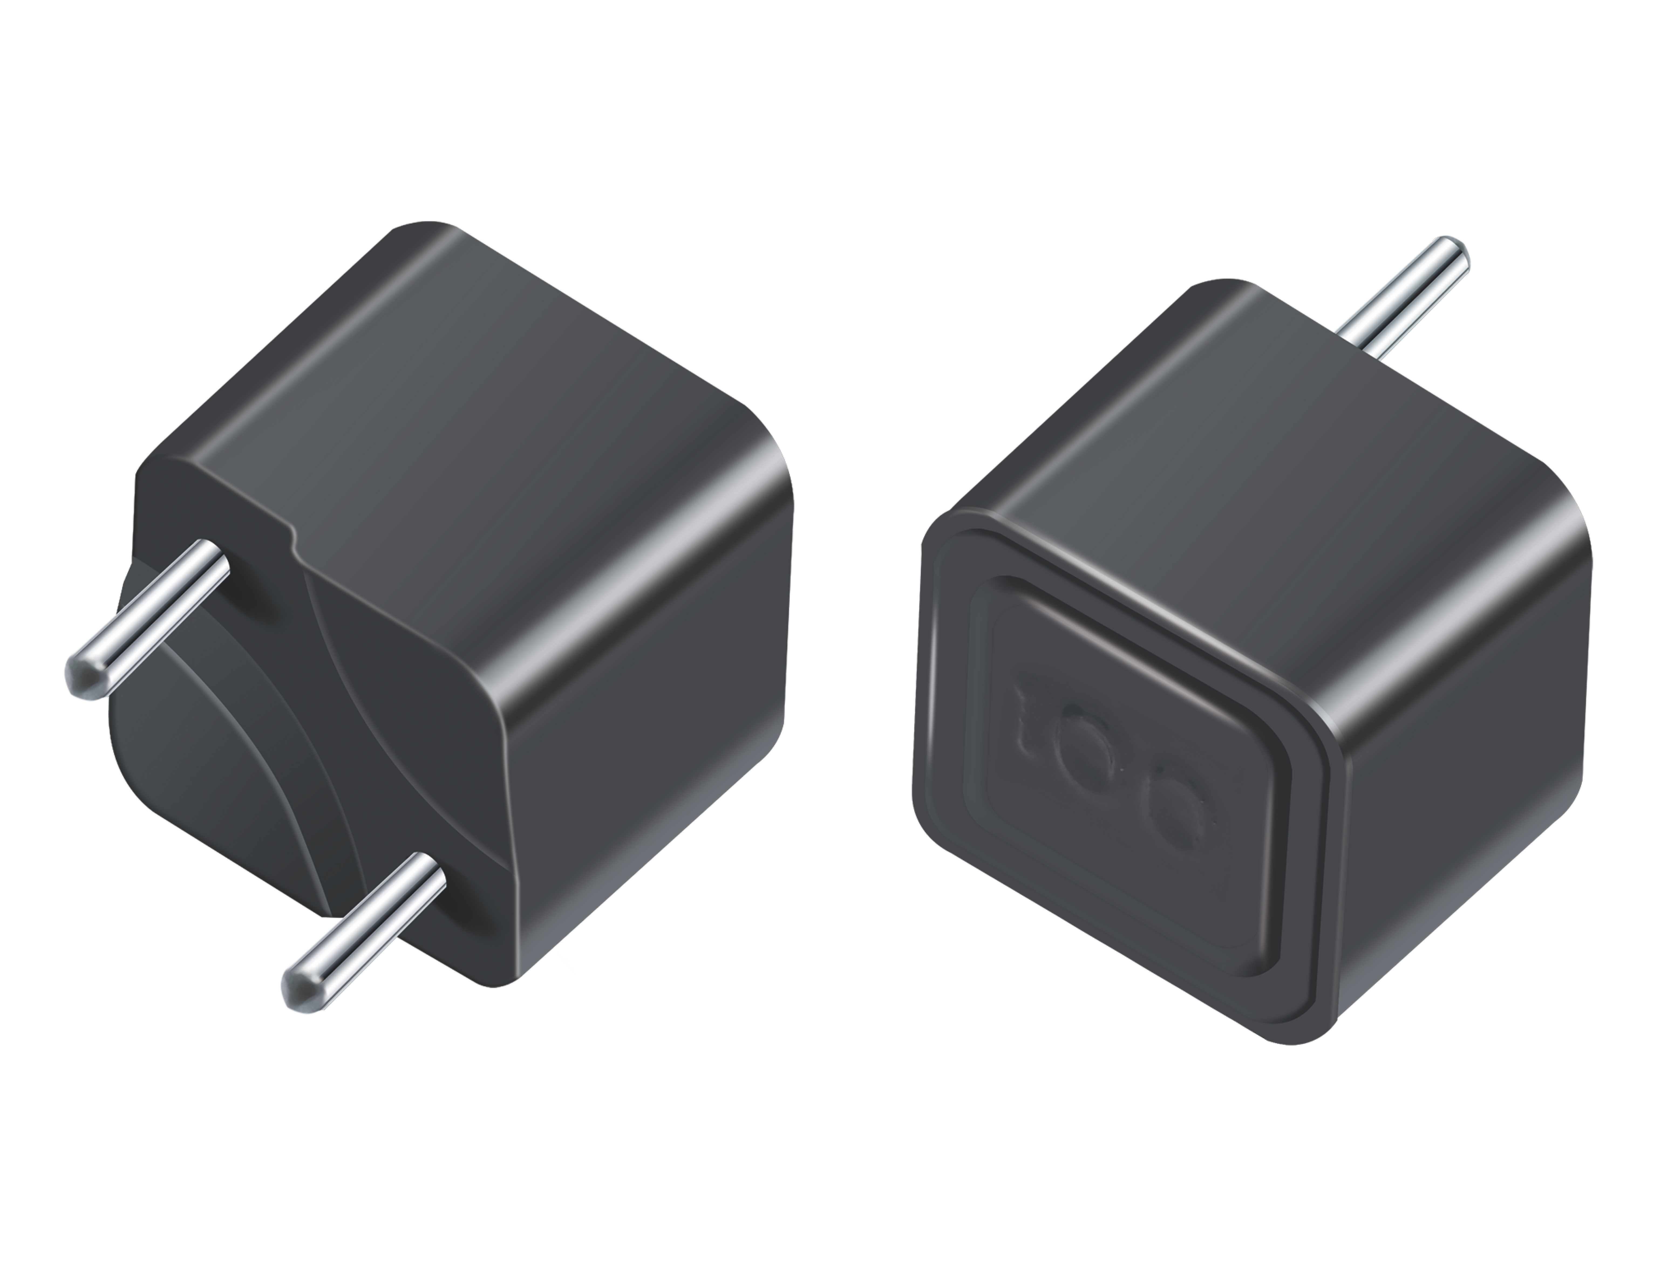
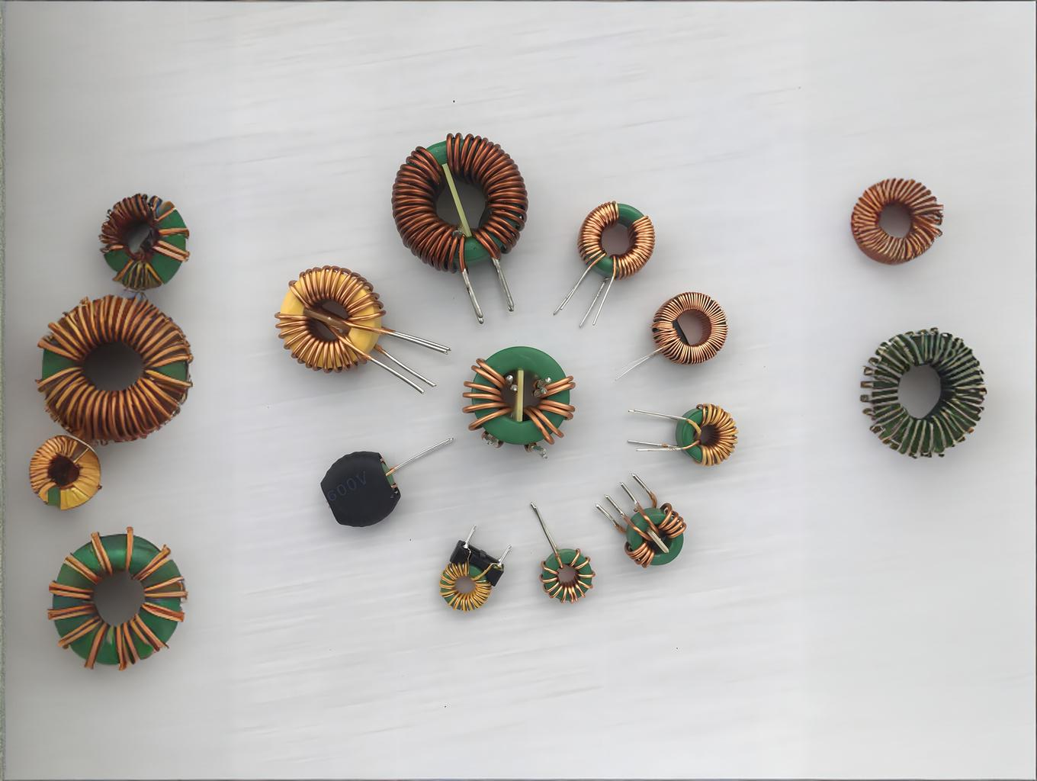
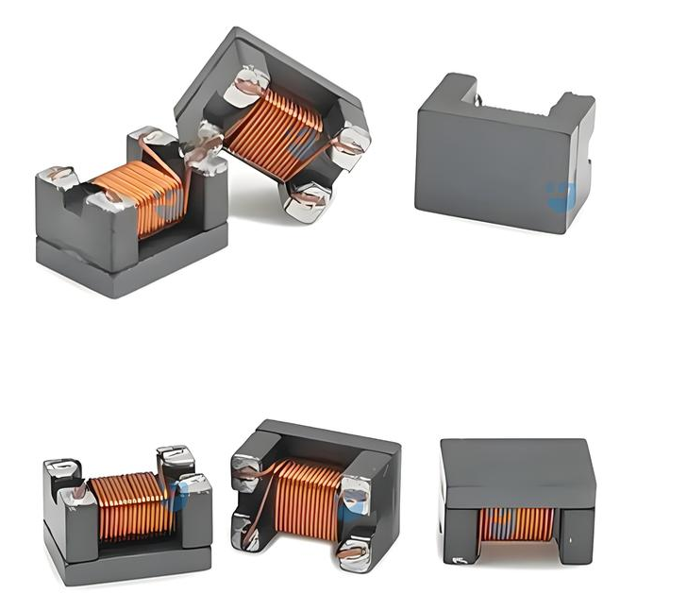

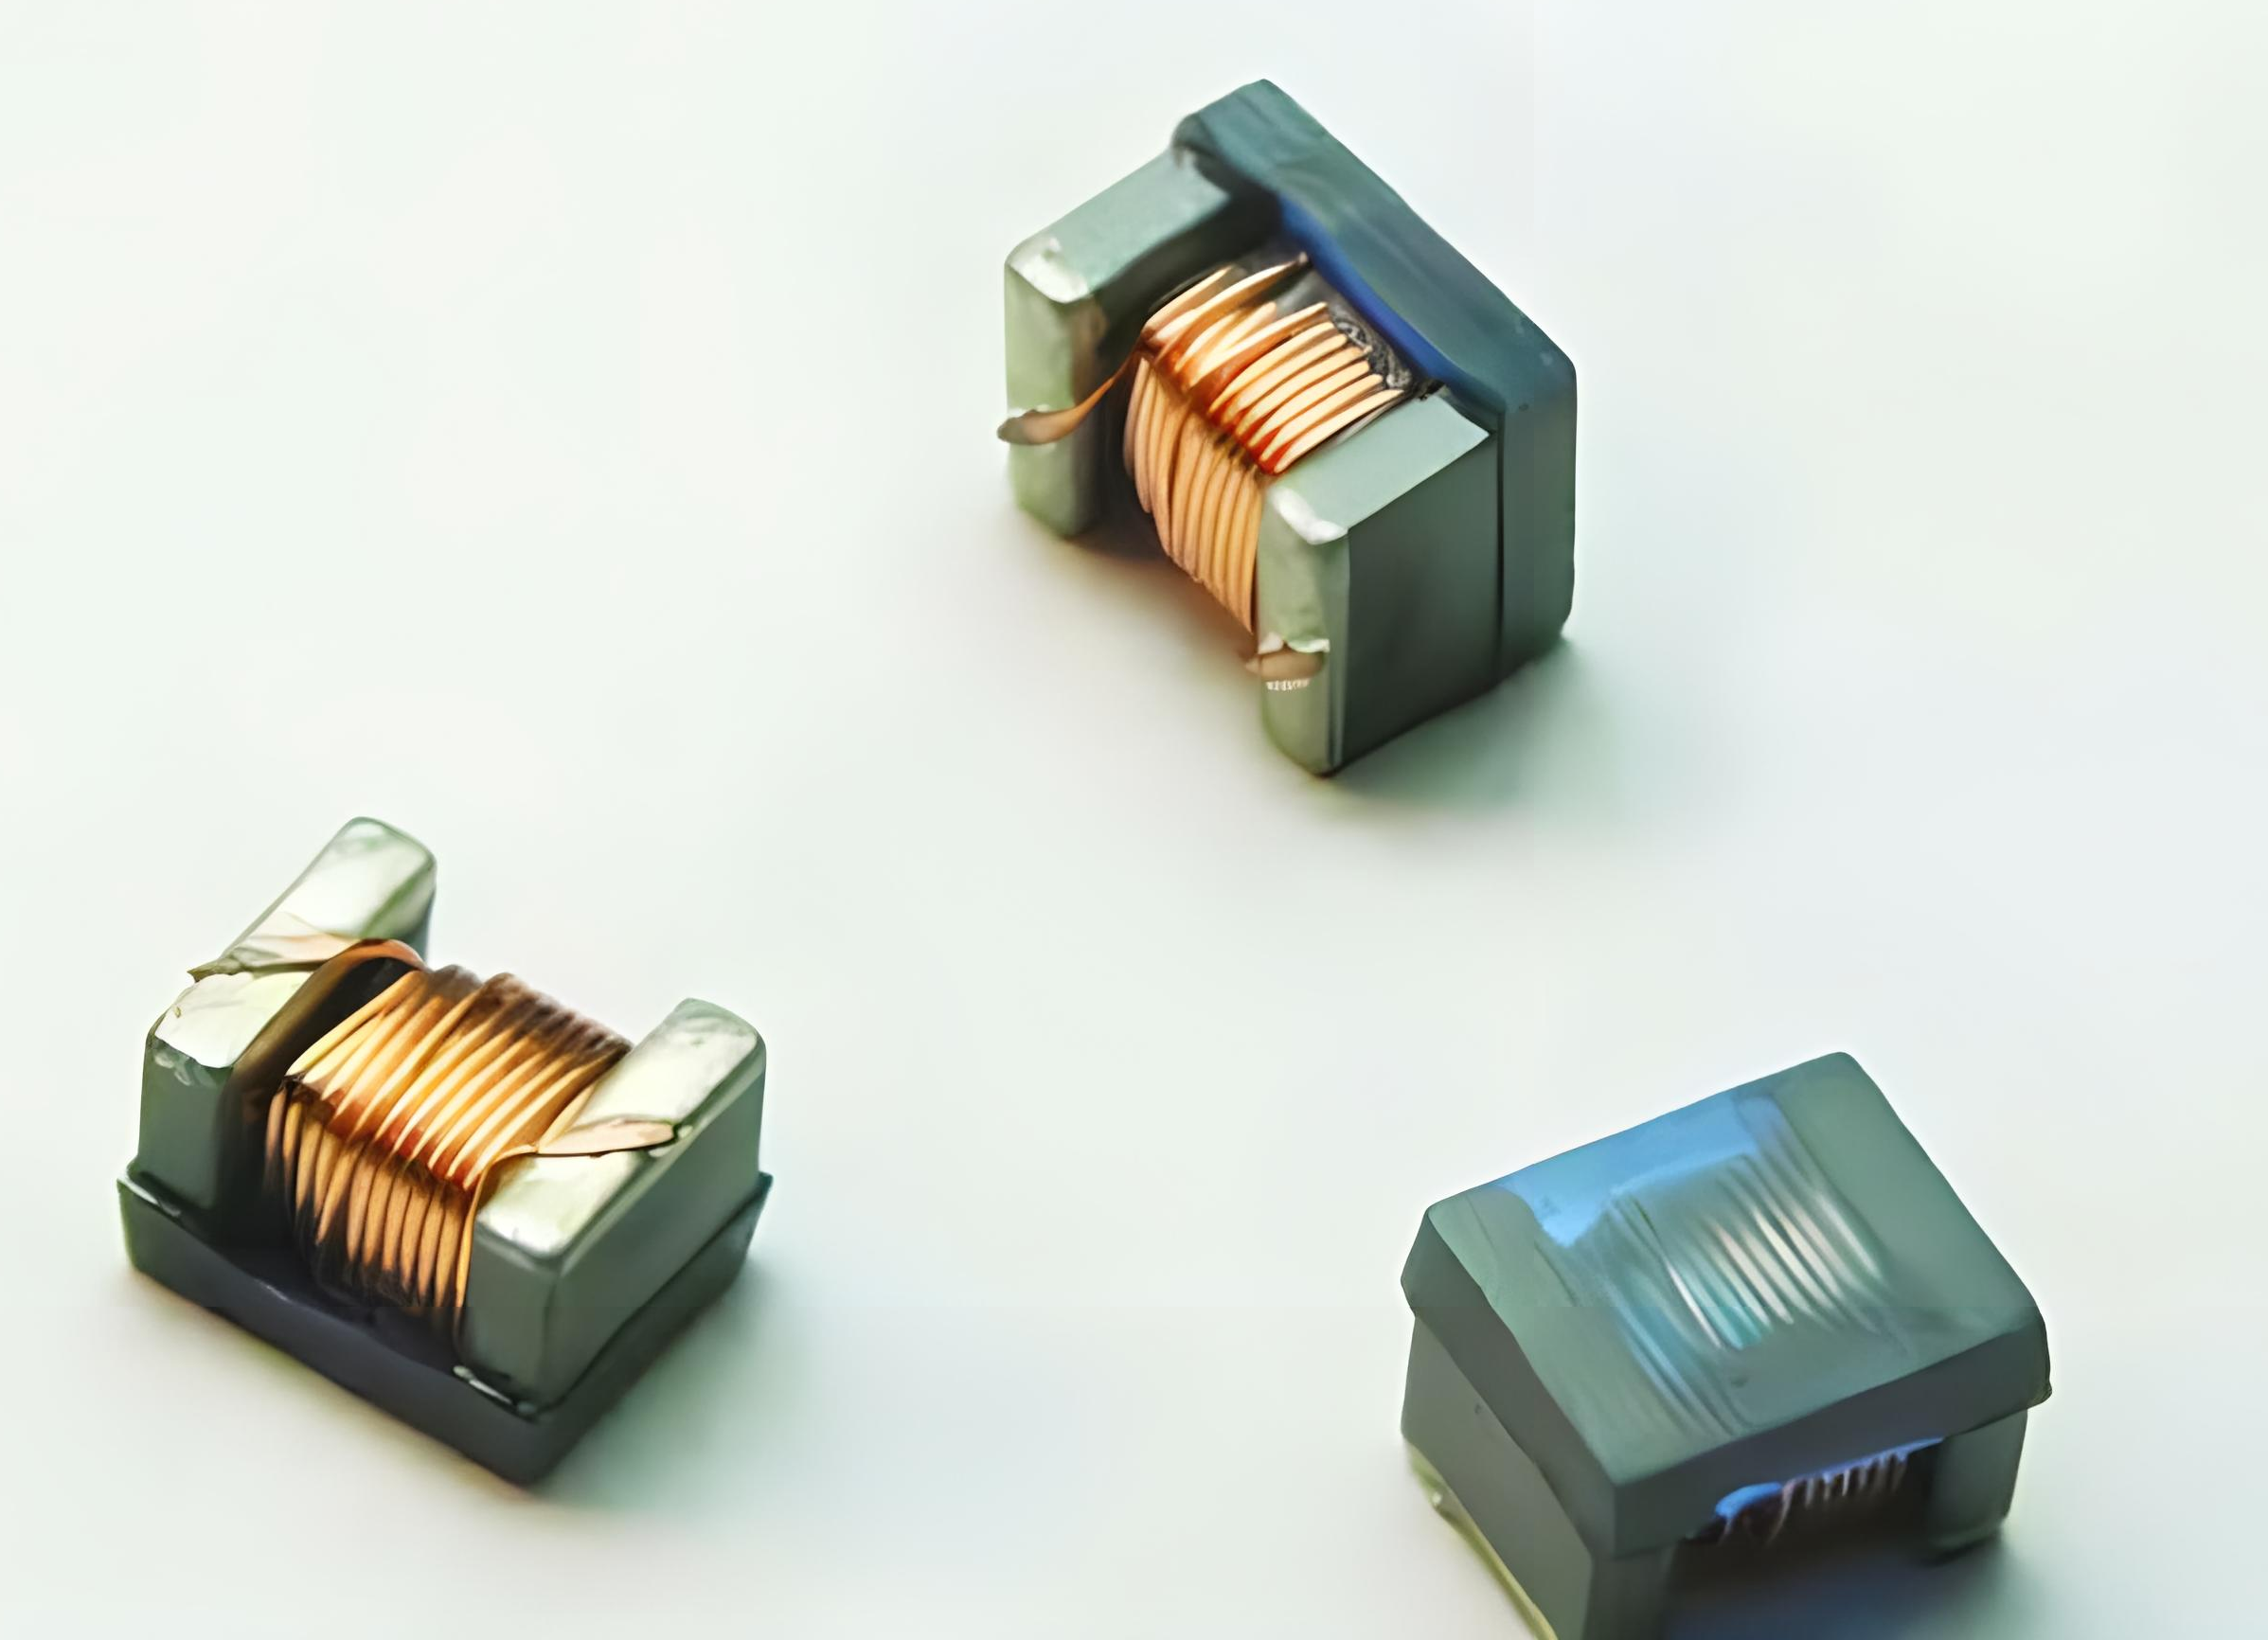
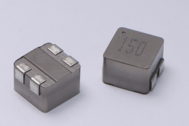
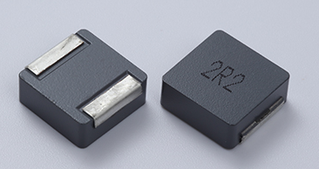
Flagship Product
Molded inductor
Common mode inductor
Toroidal inductors
Digital AMP Inductor
High frequency winding inductance
Application: Power module
Portable mobile devices, medical instruments, and industrial control equipment.
Application: Power filtering, signal line filtering, EMI suppression.
Application: DC-DC converters, inverters, and frequency converters etc; Filtering, RF signal processing and optical communication; The battery management system and on-board charger for electric vehicles etc.
Application: Digital power amplifier circuit output filtering, meeting the design requirements of high sound quality and low distortion.
Application: TWS earphone NB IoT module, smartwatch Face ID module.

Slide 13
Product technical indicators
01
Technical indicators
06
Product features
Integrated powder alloy inductors have excellent magnetic stability and temperature stability. Has good performance controllability and shape controllability
High reliability
Integrated powder alloy inductor products can meet AEC-Q200 (Level 1) requirements
02
05
Mechanical properties
Impact, drop, vibration, centrifugation,
pressure resistance
test results show that they are all better than traditional inductors
High shielding
Magnetic shielding structure, closed magnetic circuit, strong resistance to electromagnetic interference, ultra-low buzzing sound, and high-density installation
03
04
Electrical characteristics
Working Temperature
Inductance range: 0.1 μ H~450 μ H(± J/K/L/M)
Rated current range: 0.2A~80A (IDC)
Electrical strength between coil and alloy powder ≥300V (DC/IMA) Temperature rise: ≤ 40 ℃
Industrial grade: -40 ℃ TO+125 ℃
Car specification line: -55 ℃ TO+155 ℃

Slide 14
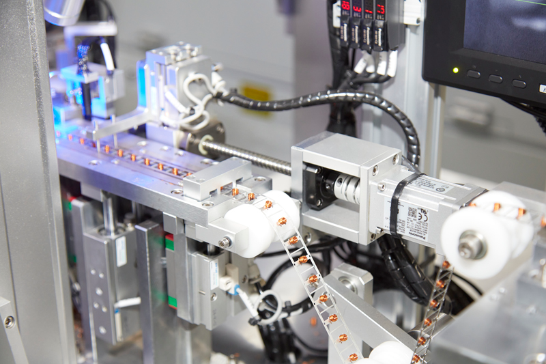

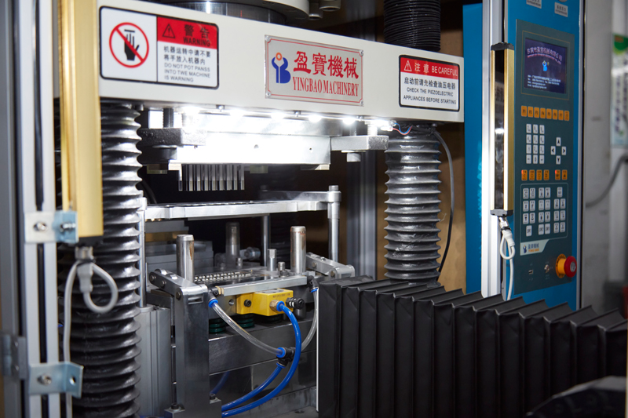
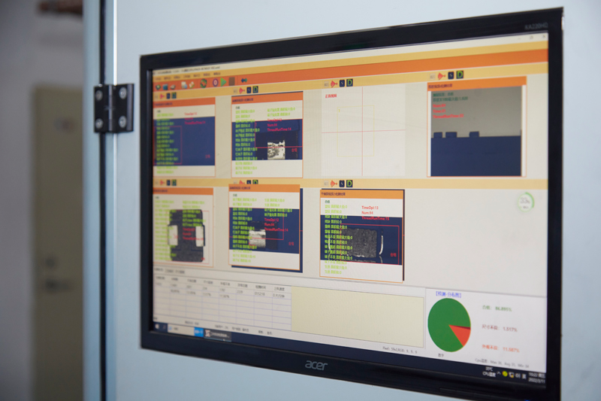
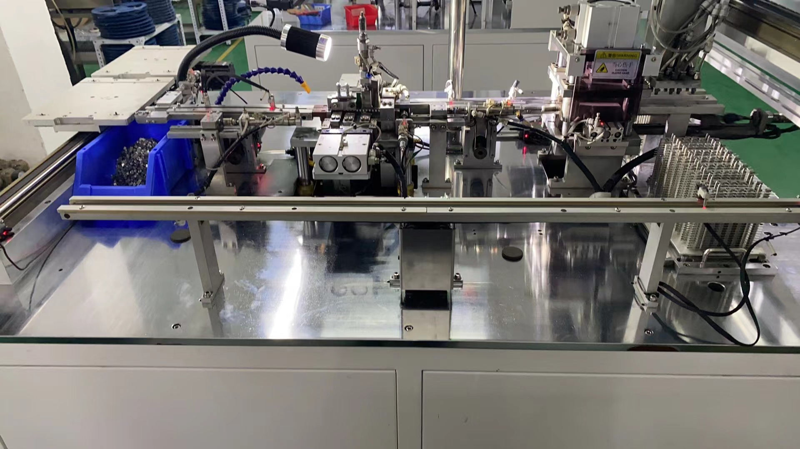
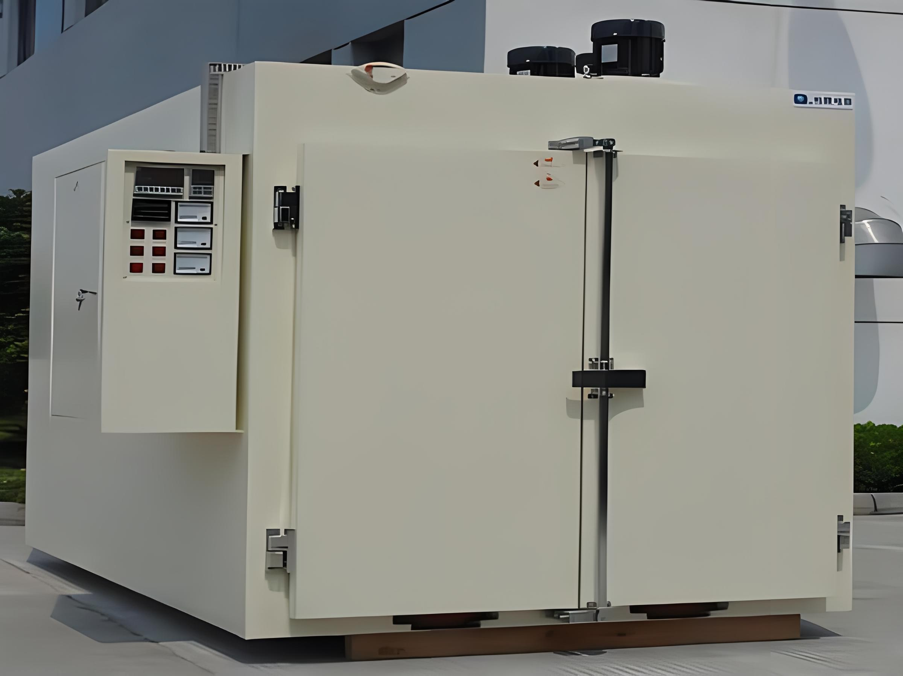
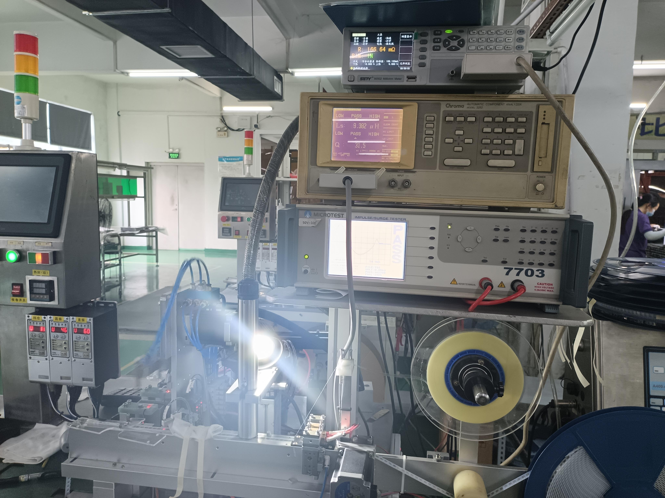
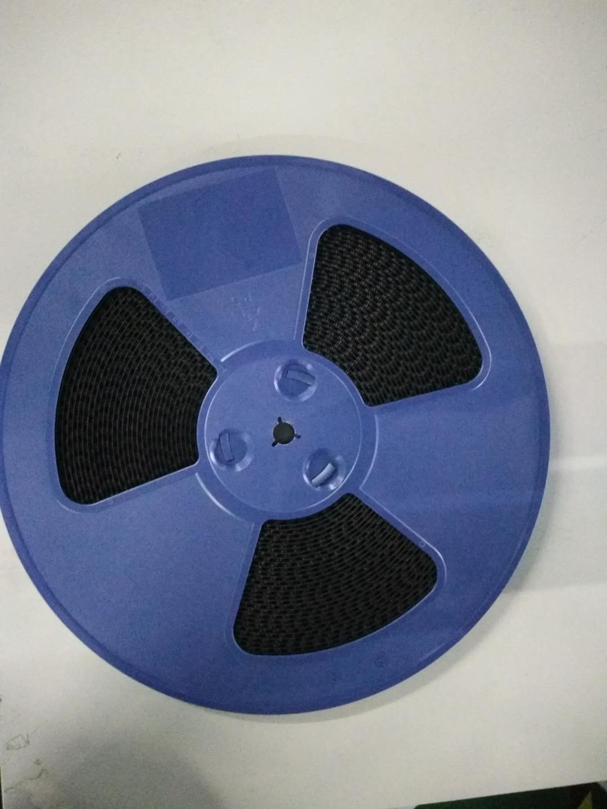
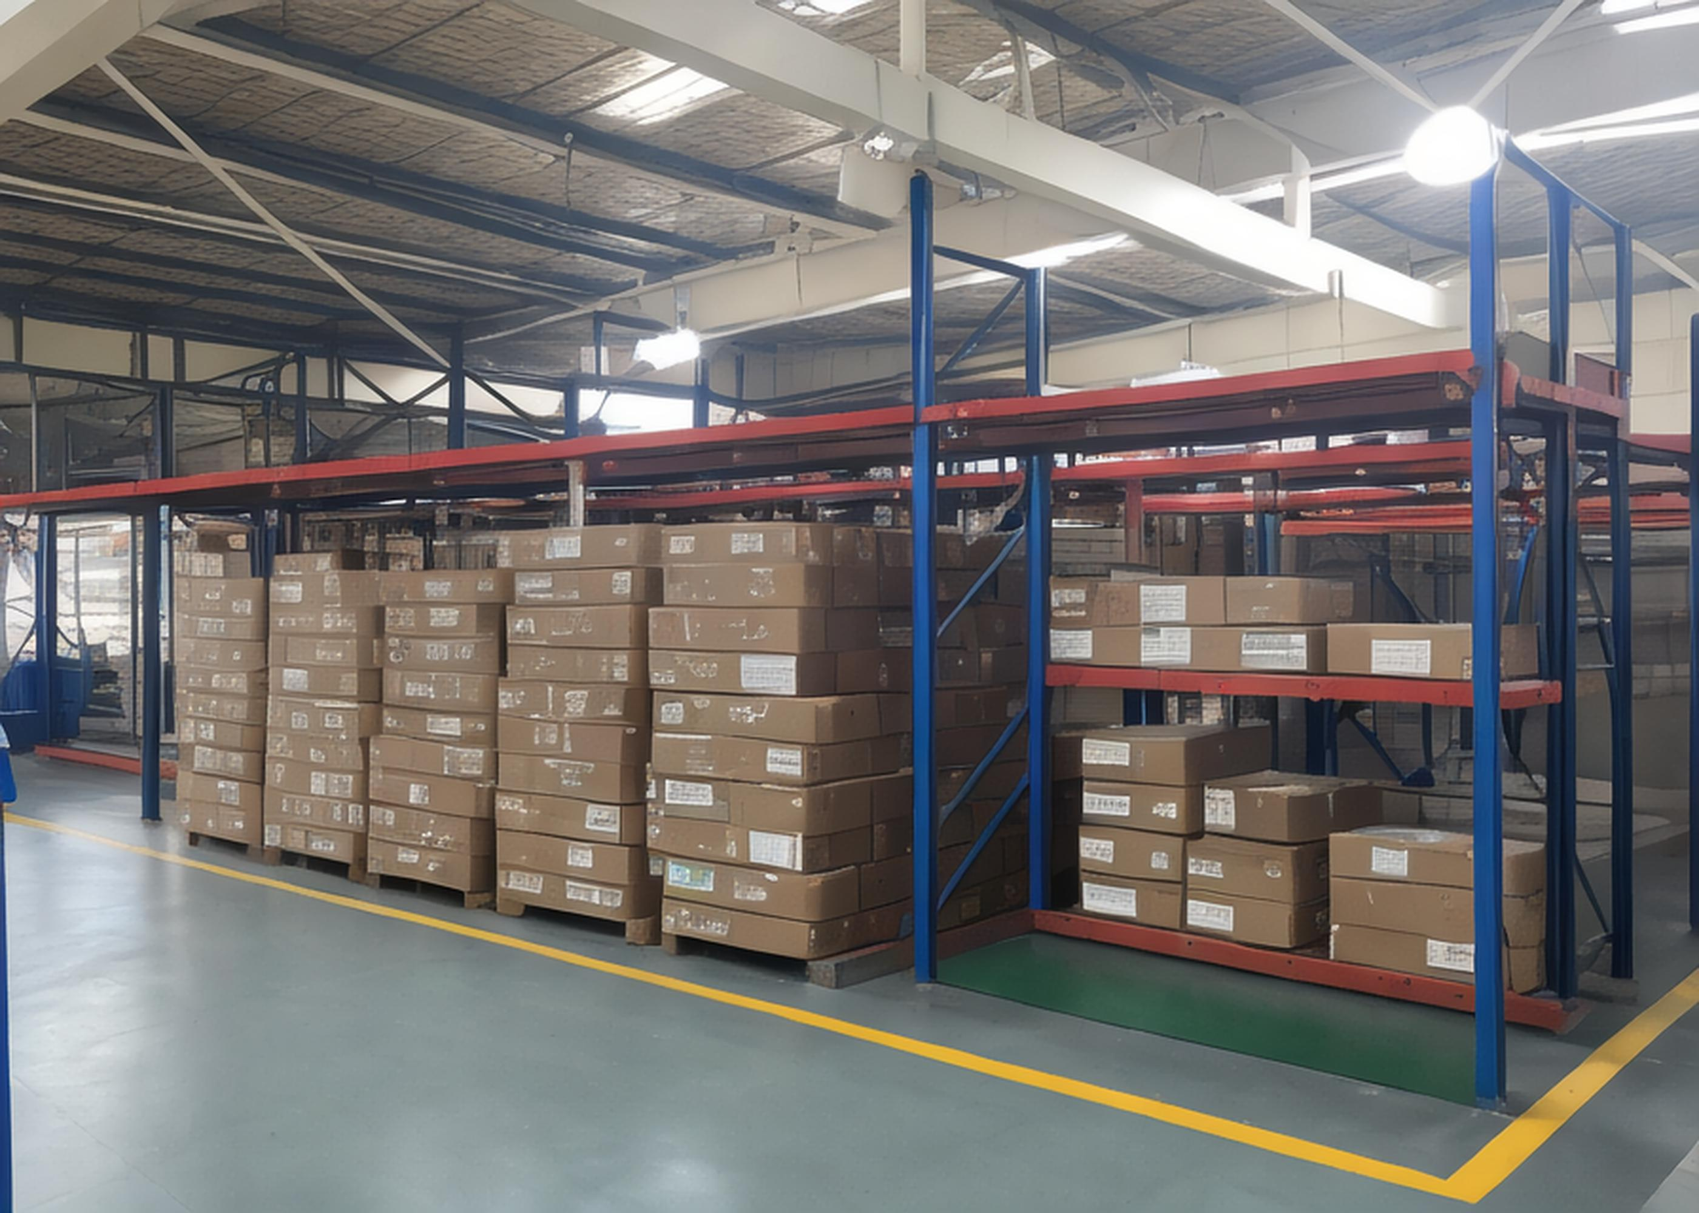
Process Flow
START
Magnetic powder
preparation
Compression Molding
Wire winding+
spot welding
Front process
Front process
Front process
Appearance
inspection
Mid stage process
Electrode
bending
High temperature
curing
Mid stage process
Electrical
testing
Printing&
packaging
Finished product
warehousing
Post process
Post process
END

Slide 15
Production Capacity
No. | NAME | QTY(unit) | Hourly production capacity （Kpcs) | Daily total production （Kpcs) | Monthly total production capacity (Kpcs)
1 | Fully automatic eight axis winding spot welding machine | 5 | 200 | 1,000 | 26,000
2 | Fully automatic three-axis winding spot welding machine | 10 | 80 | 800 | 20,800
3 | Fully automatic molding machine | 8 | 160 | 1,280 | 33,280
4 | CCD appearance inspection machine | 6 | 200 | 1,200 | 31,200
5 | Automatic package testing machine | 25 | 50 | 1,250 | 32,500

Slide 16
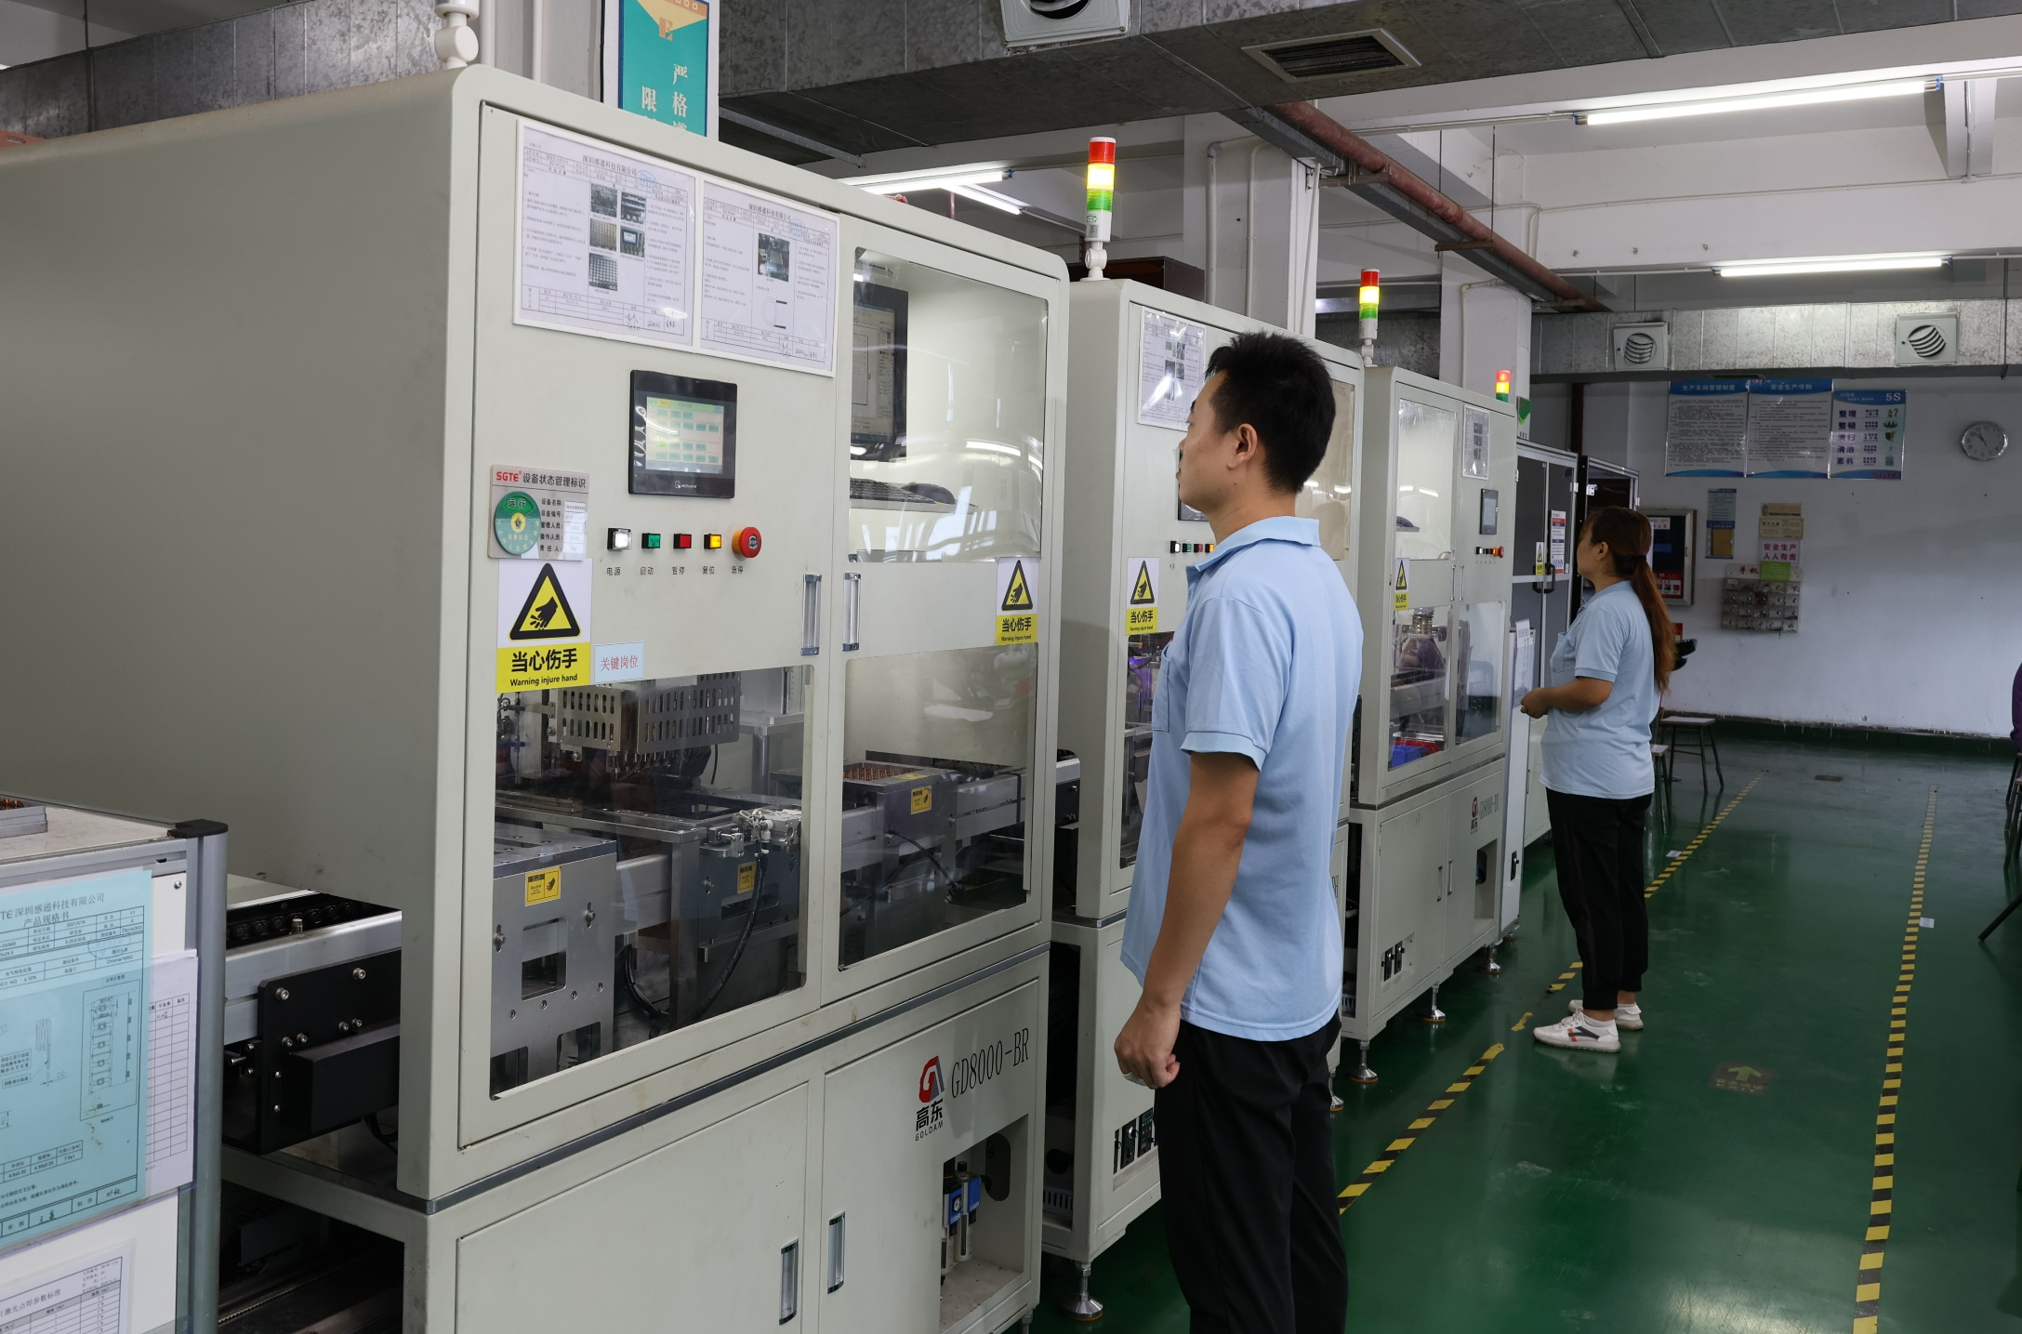
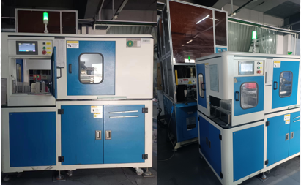



Production Equipment
Automatic wire winding welding equipment
Automatic forming equipment
Automatic cutting/bending equipment
Automatic appearance inspection equipment
Automatic testing packaging equipment

Slide 17









Detection Equipment
ROHS Detector
4284A DC Stacking tester
4285A High Frequency Tester
Pressure Resistance Tester
Interlayer Tester
CCD Tester
Resistance Tester
Tensile Tester
Spectral Analysis Tester

Slide 18







Experimental Equipment
Cold and Hot Shock Test
High Temperature and High Humidity Test
Salt Spray Test
High Temperature Life Test
Steam Aging Test
Steam Aging Test
Solderability Test
﻿
Solvent Resistance Test

Slide 19





Application Area
车 载 电 子： Car headlight、HUD、Intelligent Cockpit...
Automotive Electronics
数 据 中 心： AI、Big Data、Core Server、Neural Network...
Data Center
新 能 源： Electric Vehicle、Stored Energy...
New energy
医 疗 设 备： MRI、Hematology Analyzer、High frequency surgical knives...
Medical equipment
航 空 航 天：UAV、Navigation Satellite...
Aeronautics and Astronautics

Slide 20
3
  Our services
※ One stop service
※ Fast delivery
※ Personalized customization
PART
※ Professional team

Slide 21

One Stop Service
To provide global partners with
reliable one-stop fast and technical services for inductor professional products
We
Direct sale
Fast delivery
Global support
Continuously creating value for customers
Professional customer service team providing 7 * 24 hour service
efficient & fast delivery
convenient transportation
feedback timely

Slide 22
Fast delivery
1
3
7
15
Regular products in stock
Regular products have
semi-finished products
Regular products out of stock
Customized products
1. Samples of general products to be sent within 12 hours
2. Orders with regular items in stock will be shipped within 24 hours
1. Samples of general products to be sent within 12 hours
2. Orders with regular items in stock will be shipped within 3 days
1. When there is no stock of regular samples, samples should be sent within 3-7 days
2. Delivery of regular products within 7 days when there is no inventory for the order
1. Customized samples to be sent within 7-15 days
2. Delivery of ordered customized products within 15 days

Slide 23
Personalized customization
1
SGTE has its own R&D team, which can personalized customized products according to customer requirements
Discussion
Fusion
Customer
Demand
2
Having years of professional application experience, fully understanding customer needs, and proposing rational suggestions
The raw materials are all from the cooperation of well-known large factories, and some of them are developed in cooperation with universities to ensure the progressiveness and forward-looking nature of the materials; Lay a solid foundation for customization from the source
3

Slide 24


Professional Team
Complete organizational structure,dedicated person in charge for each department
7*24 Hours Service
Highly Stable Team
Exclusive Customer Manager

Slide 25
4
  Market & Case
※ Home Distribution
※ Industry Distribution
※Collaboration Cases
PART
※ Partners
※ Contact Us

Slide 26
Market Distribution
Europe
North America
Asia
Based on Chinese Mainland, SGTE Inductors are popular sale in Southeast Asia, Japan, Russia, Mexico, Finland, the United States and other countries and regions

Slide 27



Industry Distribution
Multimedia Audio System
Automotive Electronics
New Energy
Industrial Control
Medical Equipment
Others
The company will focus on investing and developing in the automotive electronics sector in the future, and it is expected that automotive electronics sales will account for more than 50% by 2025

Slide 28


Customer Cases
Project Name
Harman Full range of audio systems
Cooperative client（OEM factory）
GGEC Electric Company Ltd.
Eastech Electronics (Huiyang) Co., Ltd
TYMPHANY

Slide 29


Customer Cases
Project Name
Used for car light module, central control navigation module, audio-visual entertainment module, auxiliary driving module, etc
Cooperative client（OEM factory）
Beijing BDStar Navigation Co.,Ltd
Guangdong Jiali Car Lights Co., Ltd
Foshan Electric Lighting Co., Ltd

Slide 30








Partners
You will be our
Next customer

Slide 31
Contact Us
United States
Shenzhen
Hong Kong
Shenzhen Headquarters: No. 26 Wanfu Road,Gantong Industrial Park,Pinghu Street,Pinghu Community, Longgang District, Shenzhen, Guangdong Province, China
Website: www.sgte.cn
Phone: 0755-28457600 Fax: 0755-28457601

Slide 32






THANKS

